Slide 1
Software Re-Engineering
Lecture No.12 & 13
BSSE – 7 & 8
Instructor: Muhammad Usman Shahid

Slide 2
Lecture 11: Content
Code reverse engineering
Reverse engineering techniques

Slide 3
Code Reverse Engineering

Slide 4
Reverse Engineering
Reverse engineering is a process to
(i) identify the components of an operational software
(ii) identify the relationships among those components
(iii) represent the system at a higher level of abstraction or in another form.
In other words, by means of reverse engineering one derives information from the existing software artifacts and transforms it into abstract models to be easily understood by maintenance personnel.

Slide 5
Reverse Engineering
The factors demanding the need for reverse engineering are as follows:
The original programmers have left the organization.
The language of implementation has become outdated, and the system needs to be migrated to a newer one.
There is insufficient documentation of the system.
The business relies on software, which many cannot understand.
The company acquired the system as part of a larger acquisition and lacks access to all the source code.
The system requires adaptations and/or enhancements.
The software does not operate as expected.

Slide 6
Reverse Engineering
Reverse engineering is performed to achieve two key objectives:
Redocumentation of artifacts
design recovery

Slide 7
Reverse Engineering
Redocumentation:
Revising the current description of components or generating alternative views at the same abstraction level.
Design Recovery:
Creates design abstractions from code, expert knowledge, and existing documentation

Slide 8
Reverse Engineering
Six key steps in reverse engineering:
partition source code into units;
describe the meanings of those units and identify the functional units;
create the input and output schematics of the units identified before;
describe the connected units;
describe the system application; and
create an internal structure of the system.

Slide 9
Reverse Engineering Techniques

Slide 10
Reverse Engineering Techniques
Fact-finding and information gathering from the source code are the keys to the Goal/Models/Tools paradigm.
In order to extract information which is not explicitly available in source code, automated analysis techniques are used.
Notes:
Lexical analysis is the process of analyzing a string of characters (such as code) and converting it into a sequence of tokens. The tokens are then used for syntax analysis. The purpose of lexical analysis is to identify the structure of the input string and to convert it into a form that is more easily processed by the parser. The process involves breaking the input string into a sequence of tokens, which are then classified according to their type (e.g., keyword, identifier, operator, etc.)

Slide 11
Reverse Engineering Techniques
lexical analysis
Syntactic analysis
control flow analysis
data flow analysis
program slicing
Visualization
program metrics.

Slide 12
Lexical Analysis
Lexical analysis is the first phase of a compiler.
It takes modified source code from language preprocessors that are written in the form of sentences.
The lexical analyzer breaks these syntaxes into a series of tokens, by removing any whitespace or comments in the source code.

Slide 13
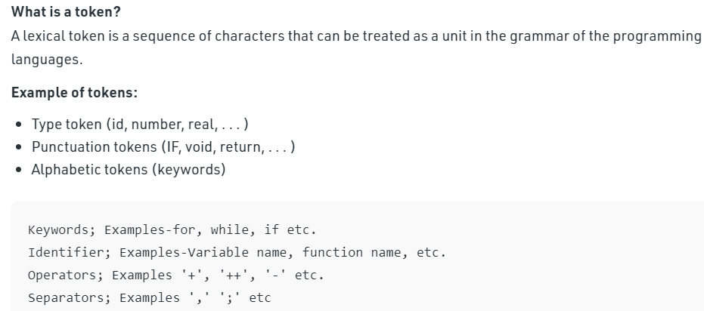
Lexical Analysis
The output is a sequence of tokens that is sent to the parser for syntax analysis

Slide 14
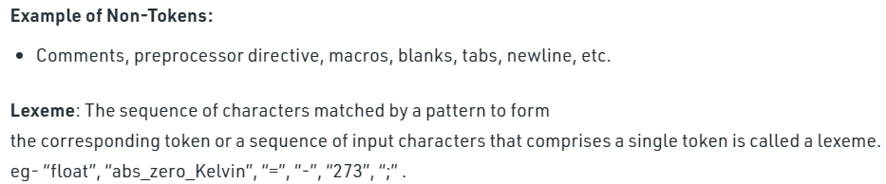
Lexical Analysis
Notes:
In programming, "macros" typically refer to small scripts or code snippets that automate repetitive tasks or expand into larger sections of code.

Slide 15
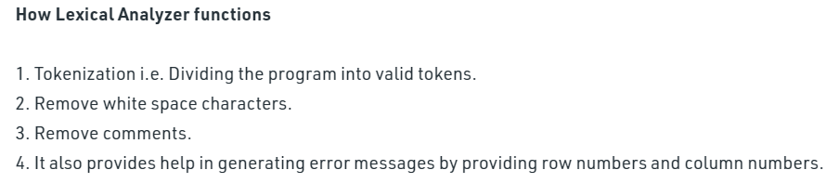
Lexical Analysis

Slide 16
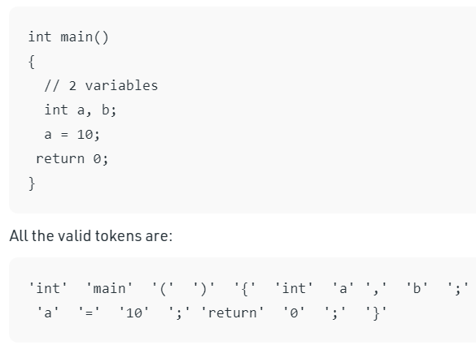
Lexical Analysis

Slide 17
Lexical Analysis
Lexical analysis is the process of decomposing the sequence of characters in the source code into its constituent lexical units.
Various useful representations of program information are enabled by lexical analysis.
A program performing lexical analysis is called a lexical analyzer, and it is a part of a programming language’s compiler.
Typically, it uses rules describing lexical program structures that are expressed in a mathematical notation called regular expressions.
Modern lexical analyzers are automatically builtin using tools called lexical analyzer generators, namely, lex and flex

